Slide 1
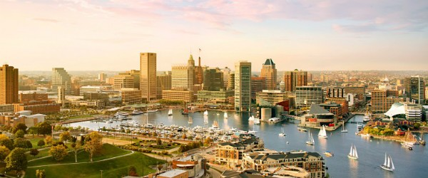
MAYOR STEPHANIE RAWLINGS-BLAKE “Continuing to Grow Baltimore” Better Schools, Safer Streets & Stronger Neighborhoods Lou Ann Blake, Esq., Chair Nollie P. Wood, Jr., Ph.D., M.P.H., PDF, Executive Director
Mayor’s Commission on Disabilities
FY 2015 Annual Report

Slide 2
Mayor Stephanie Rawlings Blake Thanks the Sponsors of this Report and Accomplishment Event
Hilton Baltimore
Johns Hopkins University and Medicine
Johns Hopkins Bayview Medical Center

Slide 3
MCD Committees and Members
Commission Development
Lou Ann Blake, Michelle Cummings, Lori Patria
Access
John Carter, JoAnn Cason, Phillip Chery, Dwight Daughton, Beverly Harris,
Brenda P. Haynes, Ph.D., Sarah Hope, Dezmaloyd Moore, Paul Overly,
Phillip Scott, Ade Shittu, C. Maria Stokes, Erin Kelly
Emergency Preparedness and Response
Cecil Fox, Crystal Bright, Bernard Douglas, Deidre Weems, Khalilah Yancey
Employment
Lou Ann Blake, Joe Chin, Kimberly Grade, Gloria Diggs, William Fields,
Raymond Holmes, Ph.D., Linda Doughty, Jessica Salmond, Ruth Ann Wynegar,
Sol Mogilensky
Legislative
Carolyn Cornick, Robert Curran, Daniel Ewald, Jack Elam, Adam Levine,
Victor Tervala
Transportation
Charles Brown, William Christian, David Greenberg, Ivor Quashie

Slide 4
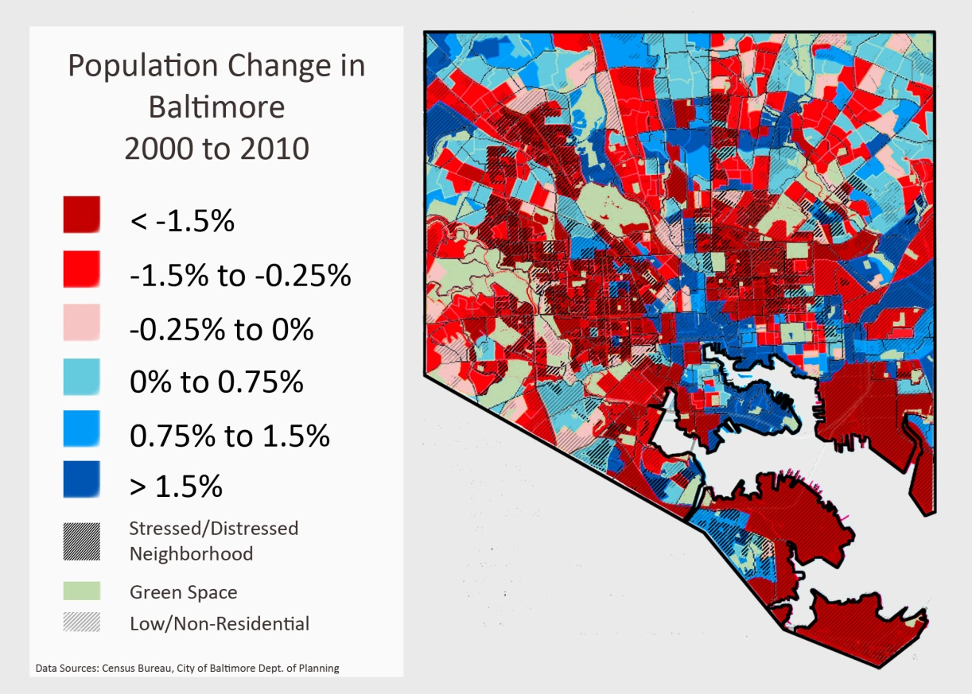
Mayor’s Primary Goal
Primary Goal: Increase the population of Baltimore City by 10,000 households/families.
Accomplishments:
The population of persons with disabilities from 2009-2011 to 2011-2013 indicates an increase from approximately 15.1% to 15.8 % of the overall population.
(based on Census data)

Slide 5
COMMISSION DEVELOPMENT ACCOMPLISHMENTS
Primary Goal: Identify Commission vacancies and recruit appropriate diverse individuals for membership categories.
Accomplishments:
Recruited, oriented and assisted three (3) potential Commission members with the Mayoral nomination process.
Achieved representation from all City Council districts, except 10, 12, and 13.
Oriented new members from the City Agencies; Office of Emergency Management and Fire Department.
Monitored attendance and, where appropriate, intervened to assist the Commission member or representative to attend the required number of meetings.
Represented the Commission at meetings and events, e.g.: The Maryland Commission on Disabilities and The Maryland Disability Forum.
Assured that accurate minutes of Commission meetings were recorded and disseminated.

Slide 6
ACCESS ACCOMPLISHMENTS
Primary Goal: Evaluate, educate, train, and assist with the improvement of accessibility at City businesses, facilities, and public/private accommodations.
Accomplishments: Visited and evaluated various types of buildings for accessibility compliance.
Horseshoe Casino
Baltimore City School Headquarters - Re-inspection (2011-2015 – 14.3% correction rate)
Baltimore City Health Department - Re-inspection (2011-2015 – 75% correction rate)
Benton Building
Abel Wolman Municipal Building Elevator evacuation plan
Completed over 45 site reviews for the Department of Public Works (DPW) Media Section, for the Mayor’s public meetings for the Consent Decree projects. The public meetings are to be held regarding DPW’s under ground infrastructure.

Slide 7
ACCESS ACCOMPLISHMENTS (CONTINUED)
Inspected 25 election sites to ensure accessibility.
Worked with the Board of Elections to inspect one (1) new early polling location and nine (9) new general election polling locations for accessibility.
Worked with the Baltimore City Schools and identified ten (10) school polling sites that needed signage corrected.
Responded to over 283 complaints and requests for assistance regarding disability services, accessibility and accommodation.
On October 4, 2014, we partnered with Global Abilities Foundation, Kennedy Krieger institute, and the Baltimore Department of Recreation and Parks to put on Recfest 2014, a day of fun, games, music, and education for over 200 persons at Patterson Park.
Partnered with the Baltimore Office of Promotion and the Arts to develop a more comprehensive Accessibility Plan for Artscape 2014, to include a revised Service Animal Policy and Maryland Transportation Authority –Mobility Services pick-up and drop- off locations.
Partnered with Best Buddies of Maryland and the Department of Human Resources to initiate hiring a person with intellectual disabilities initiative as part of the Mayor’s initiative with the U.S. Conference of Mayors.

Slide 8
ACCESS ACCOMPLISHMENTS (CONTINUED)
On October 21, 2014 at the Clyburn Park’s Volmer Center, we partnered with the Maryland Department of Housing and Community Development, Codes Administration, the American Institute of Architects - Maryland Chapter, the Baltimore Department of Recreation and Parks, and the ADA Mid-Atlantic Center, and the U.S. Access Board to put on the Accessibility for All – 2010 ADA Standards Training Conference. Over 75 participates attended throughout the Baltimore metropolitan region.
On October 9th, we partnered with the Maryland Disabilities Forum to sponsor the 4th Gubernatorial Candidates Forum at the National Federation of the Blind.
Partnered with the Law Department to develop and distribute updated information on Service Animal Policy to Cabinet members.
We partnered with the ADA Mid- Atlantic Center in a multistate project entitled - Community and Work Participation Disparities: A Program of the ADA Participation Action Research Consortium (ADA-PARC). The goal of the Baltimore project was to research the gaps, issues, and discrepancies in local transportation services for people with disabilities and develop ideas for improvements to transportation services.

Slide 9
Emergency Preparedness and Response Accomplishments
Primary Goal: Educate the community about emergency preparedness and responses, the effects of disasters, and their role in disasters.
Accomplishments:
On March 6, 2015, a “Train the Trainer” presentation occurred on removing barriers in communication with the deaf and hard of hearing community by Professor Jody H. Cripps, Towson University, Department of Audiology and Deaf Studies, at the Public Safety Facility on Northern Parkway. Six members of the Fire Department and one member of the Mayor’s Office of Emergency Management participated in the “Train the Trainer” training. Arrangements are being made to incorporate training presentations for members of the Police Department.

Slide 10
Emergency Preparedness and Response Accomplishments (continued)
On March 27, 2015, the Committee partnered with the Baltimore Region Urban Area Security Initiative (UASI) for a Conference on “Knowing What To Do and When To Do It” – An Emergency Preparedness Town Hall for People with Disabilities at Towson University.
The event featured Marcia Roth, Director of The Federal Office of Emergency Management’s Office of Disability integration, experts from the Federal Communications Commission and Hearing Loss Association of American, and survivors of disasters. Approximately 175 attendees participated in the event.
On May 27, 2015, Colonel Melvin Russell and Captain Bernard Douglas of the Police Department gave a presentation to the Mayor’s Commission on Disabilities about Community Policing and the Freddie Grey disturbance.
The presentation stressed the importance of getting the police back into the community and working with youth. By working with teens, who are still in school, in activities such as the Explorer Program, it is hoped that they will choose law enforcement careers as police officers. When police on the street are part of the community which they patrol, there is a reduction in crime.

Slide 11
EMPLOYMENT ACCOMPLISHMENTS
Primary Goal: The Employment Committee works to assure that employment-related information concerning rights, availability, and support services are readily available and accessible to all citizens of our community, including persons with disabilities.
Accomplishments:
Appointed designated Department of Human Resources (DHR) members to work with the Employment Committee.
Continued consulting with DHR designated representatives and now have the following individuals appointed to work with the Employment Committee directly:
Felicia Myers, Recruitment & Talent Acquisition Lead
Rhoda Benjamin, Human Resources Business Partner

Slide 12
EMPLOYMENT ACCOMPLISHMENTS (CONTINUED)
14
Drafted concerns and submitted to Baltimore City website: Concerns with Baltimore City’s and the Mayor’s Commission on Disability’s Website – Input from the Employment Committee
Added the Resource Guide to Baltimore City’s website: From ADA National Network “A Planning Guide for Making Temporary Events Accessible to People with Disabilities”
Guided DHR to add specific links and tabs onto the city’s website to specifically identify and provide information on Baltimore City’s Hiring Preferences for: Disability, Veterans and Residency.

Slide 13
EMPLOYMENT ACCOMPLISHMENTS (CONTINUED)
16
Continued to receive the monthly tracking schedule from DHR that is used to gather and track data/information on job applicants who have applied, been interviewed and been hired for a Civil Service job as a result of the City’s Ordinance 10-0622 “Hiring Preference for Persons with Disabilities”. Data received:
Job Applicants who Have Applied For a Civil Service Job with Test Requirement
Year | Applied | Interviewed | Hired
2011 2012 2013 2014 2015 Year-to-Date | 0 1 1 3 0 5 | 0 1 1 2 0 4 | 0 0 0 2 0 2

Slide 14
EMPLOYMENT ACCOMPLISHMENTS (CONTINUED)
16
Collaborated with the Maryland State Department of Education, Division of Rehabilitation Services to receive monthly tracking on the number of job applicants who have applied for a Certification and/or the number of applicants that were qualified/certified with a disability.
Applicants who have applied for a Certification and/or have qualified/certified with a disability
Year | Applied for Certification | Applicants Qualified/ Certified with a disability
2014 2015 Year-to-Date | 2 3 5 | 2 3 5

Slide 15
EMPLOYMENT ACCOMPLISHMENTS (CONTINUED)
14
Lou Ann Blake, Chair of the Commission, coordinated the eighth annual Jacobus tenBroek Disability Law Symposium, The ADA at Fifty: The Future of Disability Law and the Right to Live in the World, on March 26-27, 2015.
Hosted by the National Federation of the Blind Jernigan Institute.
Brought over 220 disability law scholars, advocates, and government officials from throughout North America to Baltimore to envision the status of disability and disability law in 2040 and examine what remains to be done to achieve equality of opportunity for all.
Keynote speaker was Vanita Gupta, Acting Assistant Attorney General for Civil Rights, U.S. Department of Justice.
Employment committee began the creation and development of sample flyers to be reviewed and submitted to DHR to use in their creation and implementation of a marketing campaign to educate Baltimore City Governmental Departments, City Agencies and community resources of Baltimore City’s Hiring Preference for People with Disabilities.

Slide 16
LEGISLATIVE ACCOMPLISHMENTS
Primary Goals: Monitor City legislation as well as develop and provide testimony during the Maryland General Assembly with respect to five (5) bills that affect the lives of individuals with disabilities.
Accomplishments:
State legislation: Evaluated all disability-related bills before the Maryland General Assembly. We tracked the progress of 42 bills and submitted testimony on the following 16 bills:
House Bill 100: Developmental Disabilities Administration – Medicaid Fair Hearings
Senate Bill 535 (HB152): Community Colleges – Tuition Waiver for Disabled Individuals – Requirements
Senate Bill 157: Consultation, Diagnosis, and Treatment of Mental and Emotional Disorders – Consent of Minors
Senate Bill 848: Interagency Disabilities Board – Membership and Duties – Community Inclusion Training Oversight

Slide 17
LEGISLATIVE ACCOMPLISHMENTS (CONTINUED)
Testimony provided for:
House Bill 250: Income Tax – Subtraction Modification – Elderly or Disabled Individuals
Senate Bill 397: Developmental Disabilities Administration - Licenses – Duties and Immunities – Employees
Senate Bill 538 (HB535): Blind or Visually Impaired Children – Individualized Education Programs – Orientation and Mobility Instruction
Senate Bill 562 (HB473): Tax Credits – Employment of Individuals with Disabilities
Senate Bill 563: Developmental Disabilities Administration and Maryland Medical Assistance Program – Services – Military Families
Senate Bill 761 (HB 1105): Disabled Individuals – Maryland ABLE Program - Established
Senate Bill 853 (HB1161): Ethan Saylor Center for Self Advocates as Educators

Slide 18
LEGISLATIVE ACCOMPLISHMENTS (CONTINUED)
Of the 42 bills followed, 16 became law:
Senate Bill 110: Developmental Disabilities Administration – Low Intensity Support Services
Senate Bill 74: Task Force to Study Mental Health
House Bill 293: Guardianship, Advance Directives, and Surrogates – Disabled Persons and Mental Health Services
House Bill 100: Developmental Disabilities Administration – Medicaid Fair Hearings (with MCD testimony)
House Bill 109: Guardianship of the Person – Disabled Persons – Attorney Fees
Senate Bill 157: Consultation, Diagnosis, and Treatment of Mental and Emotional Disorders – Consent of Minors (with MCD testimony)
House Bill 201: Vehicle Laws – Special Registration Plates and Parking Placards for Individuals with Disabilities – Licensed Physical Therapists
Senate Bill 174: Behavioral Health Administration - Behavioral Health Advisory Council

Slide 19
LEGISLATIVE ACCOMPLISHMENTS (CONTINUED)
Of the 42 bills followed, 16 became law:
Senate Bill 321: Baltimore City and Baltimore County – Police Mental Health Units – Pilot Program
House Bill 535: Blind or Visually Impaired Children – Individualized Education Programs – Orientation and Mobility Instruction (with MCD testimony)
House Bill 473: Tax Credits – Employment of Individuals with Disabilities
Senate Bill 563: Developmental Disabilities Administration and Maryland Medical Assistance Program – Services – Military Families (with MCD testimony)
House Bill 562: Health Insurance – Ambulance Service Providers – Direct Reimbursement – Repeal of Termination Date (with MCD testimony)
Senate Bill 761: Disabled Individuals – Maryland ABLE Program – Established (with MCD testimony )
House Bill 1161: Ethan Saylor Center for Self Advocates as Educators (with MCD testimony )
House Bill 1172: Individuals with Developmental Disabilities – Providers - Licenses

Slide 20
TRANSPORTATION ACCOMPLISHMENTS
Primary Goal: To improve transportation services and parking for people with disabilities.
Accomplishments:
Partnered with the Baltimore Police Dept., the City and State Departments of Transportation and the MD Motor Vehicle Administration for targeted education and enforcement of accessible parking. The Accessible Parking Education and Enforcement Day was held on 10/15/14, resulted in:
50 citizen contacts
7 placards being confiscated
12 citations issued
$4,684 in citation revenue

Slide 21
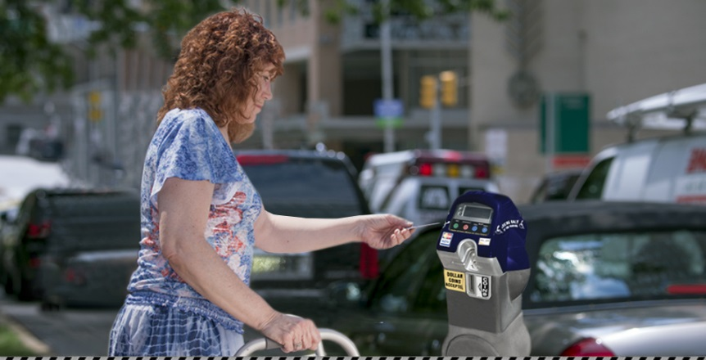
TRANSPORTATION ACCOMPLISHMENTS (CONTINUED)
Partnered with the Parking Authority of Baltimore City to provide feedback and awareness for Project Space initiative to improve accessible street parking in Baltimore. As of June, 2015, this partnership has resulted in:
The percentage of vehicles displaying a disability placard or plate while parked at a meter is at 5.5%
The percentage of total metered parking spaces occupied is at 69% (ideal number is between 80 and 85%)
The percentage of parking meters/spaces reserved for people with disabilities that are being used is 35.3%
The number of disability placards reported as stolen to the Baltimore City Police Department is averaging 3 per month
Total parking meter revenues are up by $1.57 million (13.8%) vs. same period last year

Slide 22
TRANSPORTATION ACCOMPLISHMENTS (CONTINUED)
Reviewed City information on street renovation projects to provide meaningful feedback for public access to government buildings, downtown and Park Heights locations.
Advocated for improved Mobility services for paratransit users in Baltimore City through MTA’s Citizens Advisory Committee on Accessible Transportation as well as other local advocacy groups. This advocacy has resulted in a Mobility 90 day improvement plan that the committee will be monitoring. The plan includes:
Maximizing number of vehicles during peaks
Assigning operators based on demand
Improving the Mobility scheduling software
Updating the Trapeze GPS system maps
Putting 34 new vehicles into service
Updating the Mobility Radio systems
Revamping the No-Show validation procedures
Hiring additional 12 Call Center Agents

